Slide 1
BATTLE OF THE NEIGHBORHOOD
-by DEVANSH JAIN

Slide 2
INTRODUCTION
People across the globe , are unaware of the fact that it is possible to know the best location where they can reside if they wish to shift their home to a particular location. In my Project I have taken an example of a person shifting to Toronto, Canada . Around 187,950 people migrated from across the world to toronto , Canada between the year 2011 to 2016, which makes it 6.1 % of the total population.

Slide 3
Different people of varied culture and background have different needs. Some move in with a family, some are students, some of them want to just start a business and are looking for a better place to start their small businesses but are unaware are less educated as to where should they start their base. Right Place to start a family or a business matters. Having a proper and a perfect location will decide whether a family will have all the things they need is present , and whether a businessman will have a successful business or not.

Slide 4
THE TARGET AUDIENCE:
The family (having a kid) who needs to migrate to Toronto Borough and are in search of a good place having basic amenities and requirements like a school or a university, malls, restaurants, hopitals, gym and a few more .
Small businessman who wants to grow or build their business and wants to know which place has less density or restaurants or gym or malls and also their ratings , likes , etc.

Slide 5
OBJECTIVE:
The objective of my project is to make people aware of the places that are suitable to them by providing them details about the places that they wish they had near them. This project also provides the ratings , number of likes and tips of that particular place of the neighborhood of the respective Borough.
In my project I have considered three Borough of Toronto - North York, East Toronto and Central Toronto.

Slide 6
DATA REQUIRED FOR THE PROJECT:
To solve this problem I needed some data :
All the Borough of Toronto so as to take out the considered Borough for the project.
2. Latitudes and longitude needed of the respective Borough of Toronto (so as to pass the location to the foursquare API).
3. Venue details of the places nearby the Borough of Toronto.
4. Ratings , Likes and Tips of the place nearby the Borough of Toronto.

Slide 7
SOURCE FOR THE DATA:
To get the neighborhoods of Toronto, I took help of “https://en.wikipedia.org/wiki/List_of_postal_codes_of_Canada:_M” . I web scrapped this webpage using “ beautifulSoup” .
2. I got the Latitude and the Longitude of the respective neighborhoods of Toronto through “https://cocl.us/Geospatial_data”.
3. To get the venue details such as name and category of that place and their ratings I took help of Foursquare API via the request library of Python which sent me a json data. Fourquare API has a database of 100+ million places .

Slide 8
METHODOLOGY
First of all we will need the data which we will get from "https://en.wikipedia.org/wiki/List_of_postal_codes_of_Canada:_M" by web scraping it with the help of a library called "BeautifulSoup" . We will extract all the neighbourhoods of Toronto and clean and process the data.
We will use the geographical coordinates of longitudes and latitudes which we will will get through geocoder package , so that we can use it in FOURSQUARE API.

Slide 9
We will use folium package to visualize the neighborhoods of Toronto, Canada.
Then we will get the data required for the project such as venue category and name of venue and also ratings with the help of request library and FOURSQUARE API.
Now, finally we will visualize the data to check the best option with the help of python libraries.

Slide 10
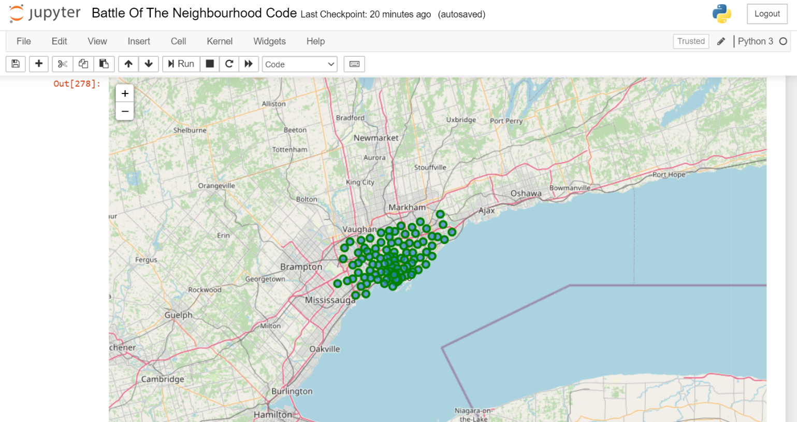
Map of all the neighbourhoods present in the boroughs of Toronto, Canada

Slide 11
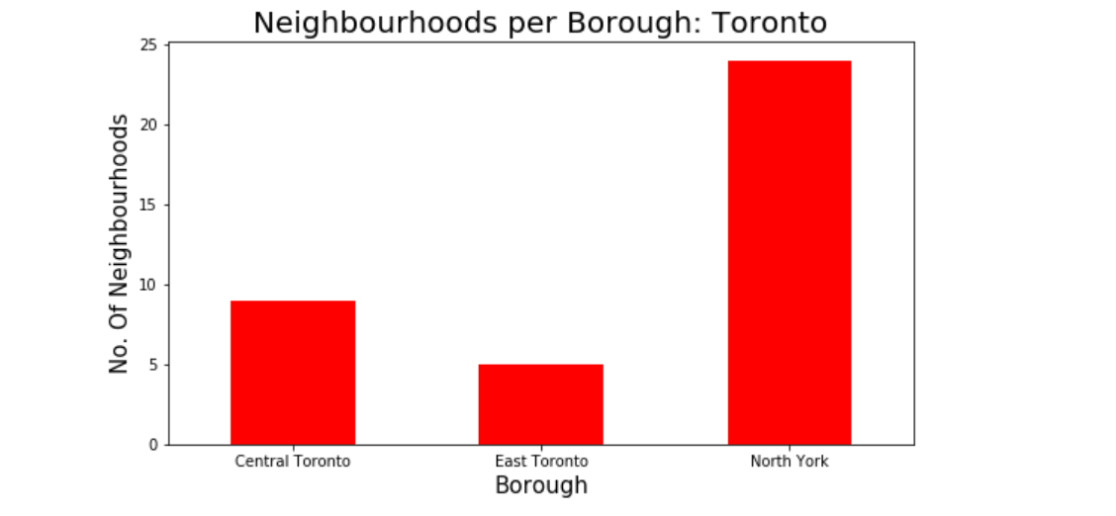
BAR GRAPH
SHOWING THE NUMBER OF NEIGHBOURHOODS OF EACH BOROUGH.

Slide 12
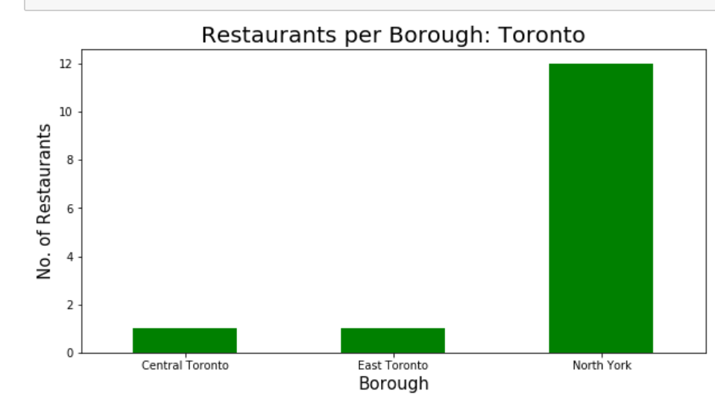
BAR GRAPH FOR RESTAURANT
SHOWING THE NUMBER OF RESTAURANTS PRESENT IN EACH BOROUGH OF TORONTO, CANADA WITHIN THE RADIUS OF 4KM.

Slide 13
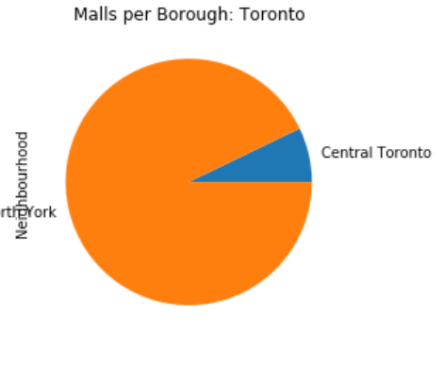
PIE GRAPH FOR MALLS
SHOWING THE NUMBER OF MALLS PRESENT IN EACH BOROUGH OF TORONTO, CANADA WITHIN THE RADIUS OF 4KM.

Slide 14
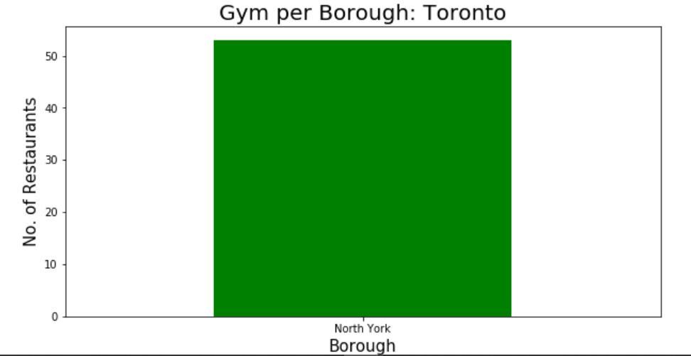
BAR GRAPH FOR GYM
SHOWING THE NUMBER OF RESTAURANTS PRESENT IN EACH BOROUGH OF TORONTO, CANADA WITHIN THE RADIUS OF 4KM.

Slide 15
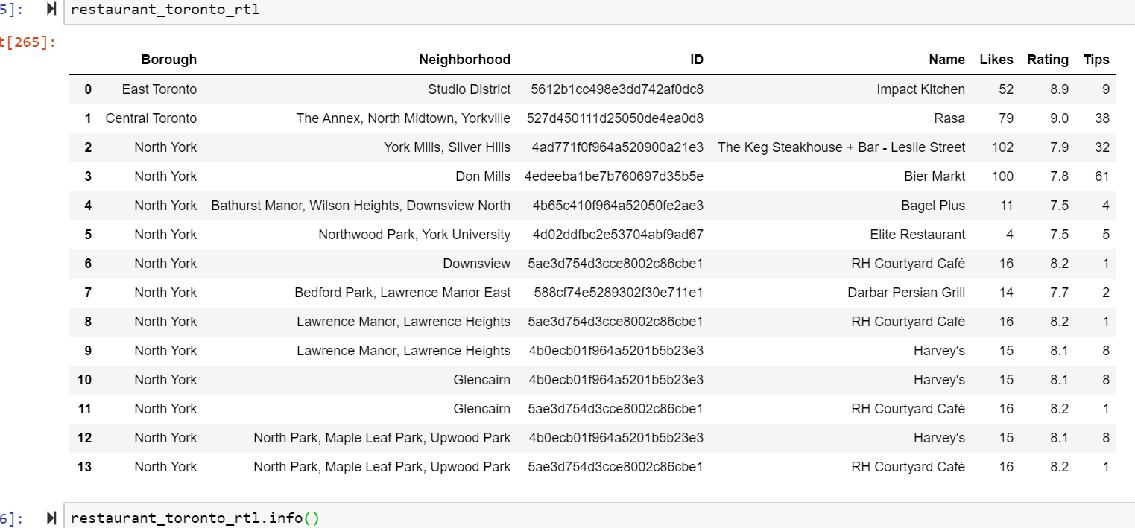
FOR RESTAURANT:
SHOWING THE NUMBER OF RATING, LIKES AND TIPS OF THE VENUE PLACES PRESENTIN THE NEIGHBOURHOODS OF BOROUGHS OF TORONTO, CANADA WITHIN THE RADIUS OF 4KM.

Slide 16
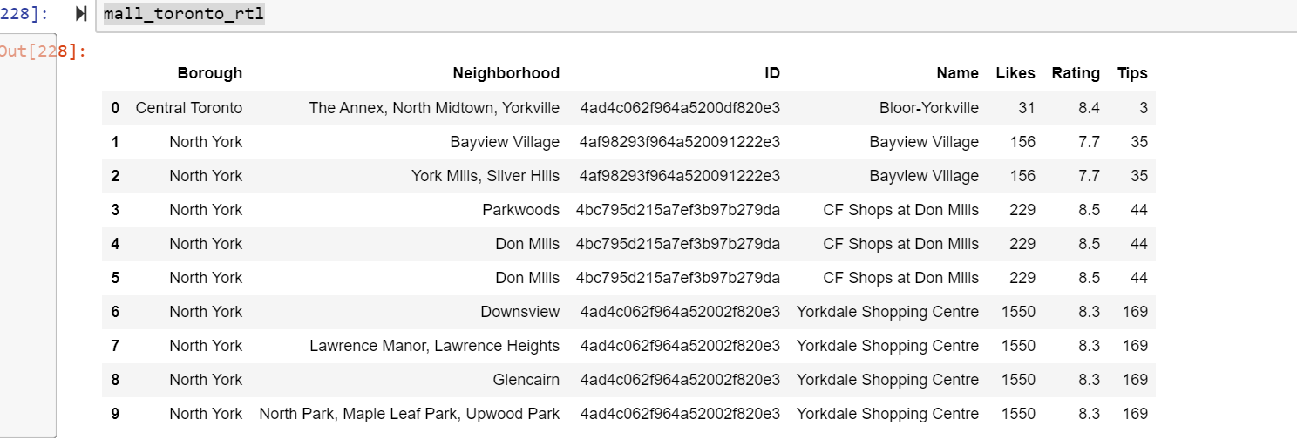
FOR MALLS:
SHOWING THE NUMBER OF RATING, LIKES AND TIPS OF THE VENUE PLACES PRESENTIN THE NEIGHBOURHOODS OF BOROUGHS OF TORONTO, CANADA WITHIN THE RADIUS OF 4KM.

Slide 17
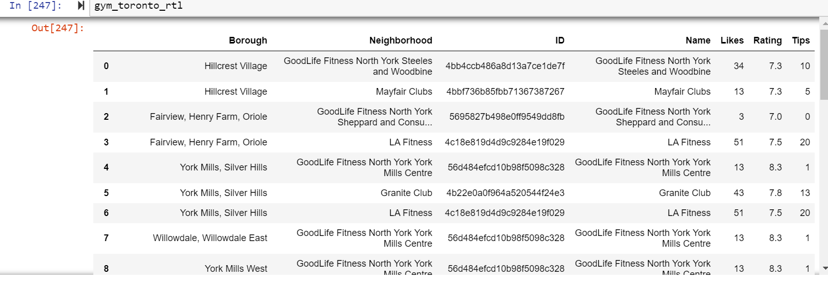
FOR GYMS:
SHOWING THE NUMBER OF RATING, LIKES AND TIPS OF THE VENUE PLACES PRESENTIN THE NEIGHBOURHOODS OF BOROUGHS OF TORONTO, CANADA WITHIN THE RADIUS OF 4KM.

Slide 18
CONCLUSION
The result we get from the above analysis is that among the three neighborhoods- North York , East Toronto and Central Toronto, North York is the best place to live. Comparing the number of neighborhoods - North York has more neighborhoods than the other three as per the bar graph that we got in the code. North York has 12 restaurants within the radius of 4 km while the other two has only two. North York has more malls and the only borough with a gym in the vicinity of radius 4km. The only disadvantage of living in this area is that none of the borough has a University or a Hospital within 4km radius.
For the business people, East and Central Toronto would be a better place to start their restaurant , gym or Mall because the density of these venues is very less in these places.

Slide 19
THANK YOU.

